Slide 1
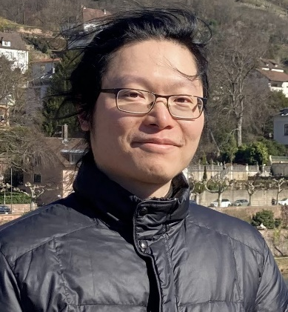
Thursday, December 1, 2022 11:00 AM
1F
1F
Mechanical local-excitation global-inhibition system dictates neuronal polarization
Dr. Tien-Chen Lin 林天正 Postdoctoral Fellow
Supervisor: Dr. Frank Bradke
German Center of Neurodegenerative Disease (DZNE)
Germany
Host: Dr. Pei-Lin Cheng 鄭珮琳

