Slide 1
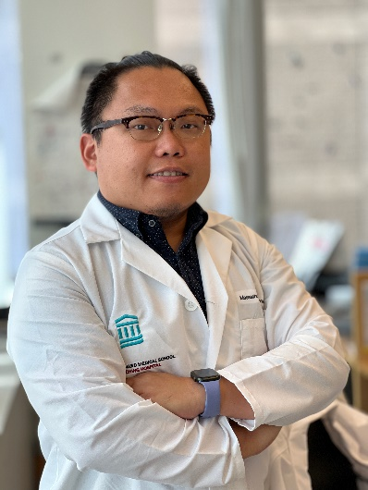
Tuesday, December 20, 2022 11:00 AM
B1
B1
The role of oncometabolite in cancer:
The crosstalk between cancer cells and tumor microenvironment
Dr. Meng-Ju Wu 吳孟儒 Instructor
Massachusetts General Hospital
Cancer Center
Harvard Medical School
Broad Institute
Host: Dr. See-Yeun Ting 陳詩允

