Slide 1
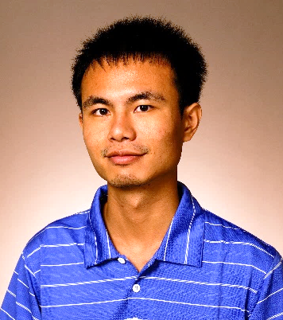
Thursday, November 24, 2022 11:00 AM
IMB-IBC Joint Postdoc Seminar
B1
B1
Dynamic remodeling of host membranes by self-organizing bacterial effectors
Dr. Ting-Sung Hsieh 謝廷松 Postdoctoral Fellow
Laboratory of Dr. Vincent Tagliabracci
Department of Molecular Biology
UT Southwestern
Host: Dr. Jen-Hsuan Wei 魏妊亘

