Slide 1
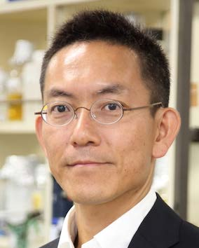
Thursday, November 10, 2022 11:00 AM
B1
B1
Acidic-rich nascent peptide-induced noncanonical translation and the impact on proteomes
Dr. Hideki Taguchi Professor
Cell Biology Center
Institute of Innovative Research
Tokyo Institute of Technology
Host: Dr. Hsueh-Chi Sherry Yen 顏雪琪

