Slide 1
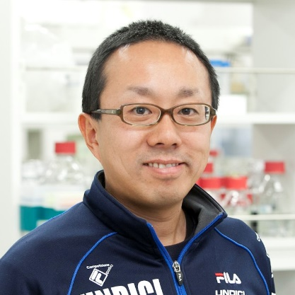
Monday, November 7, 2022 11:00 AM
B1
B1
Unraveling the dynamic 3D genome architecture through single-cell DNA replication profiling
Dr. Ichiro Hiratani Team Leader
Lab for Developmental Epigenetics
RIKEN Center for Biosystems
Dynamics Research, Japan
Host: Dr. Jun-An Chen 陳俊安

