Slide 1
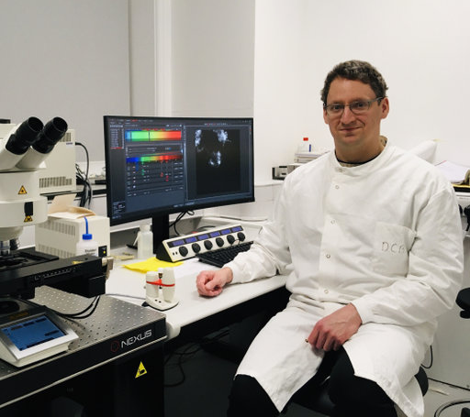
Tuesday, September 20, 2022 2:30 PM
1F
1F
Meiotic recombination and chromatin structure in germ cells contribute to genome evolution
Dr. Christophe Lambing Head of group
Department of Plant Sciences
Rothamsted Research
Harpenden, UK
Host: Dr. Ting-Fang Wang 王廷方

