Slide 1
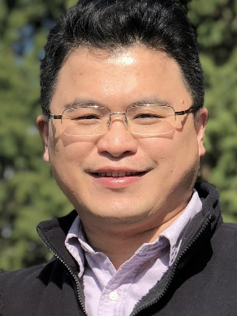
Monday, September 19, 2022 11:00 AM
B1
B1
High density CMOS IC chip enabling scalable DNA synthesis for data storage and biomedical engineering
Dr. Cedric Wu 吳政憲 Vice President
Innovation Center/New Product R&D
GenScript Biotech Corp.
Piscataway NJ, USA
Host: Dr. See-Yeun Ting 陳詩允

