Slide 1
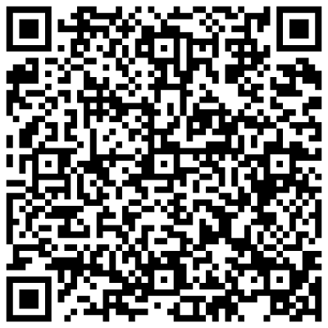
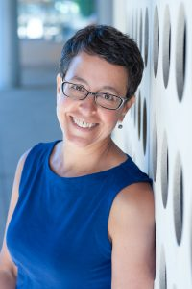
Wednesday, September 14, 2022 11:00 AM
IMB/GSB Joint Seminar
Online Webinar
Link to Webex
Dissecting trait variation between
long-diverged species
Dr. Rachel Brem Associate Professor
Dept .of Plant and Microbial Biology
University of California, Berkeley
USA
Host: Dr. Yen-Ping Hsueh

