Slide 1
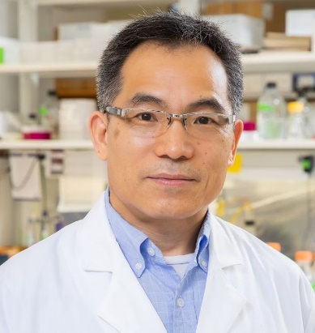
Thursday, September 8, 2022 11:00 AM
B1
B1
Aging-relevant human neurons to model neurodegeneration
Dr. Chun-Li Zhang 張春立 Professor
Department of Molecular Biology
Center for Regenerative Science and Medicine
UT Southwestern Medical Center
Dallas, TX, USA
Host: Dr. Pei-Lin Cheng 鄭珮琳

