Slide 1
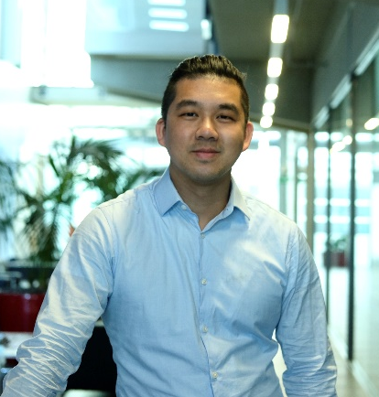
Wednesday, June 15, 2022 11:00 AM
Postdoc Seminar
1F
1F
Safeguarding Transcription during Epigenetic Reprogramming
Dr. Tien-Chi Huang (黃天祺) Postdoctoral Research Scientist
PI: Prof. Petra Hajkova
MRC London institute of Medical Sciences
(LMS), UK
Host: Dr. Jun-An Chen (陳俊安)

