Slide 1
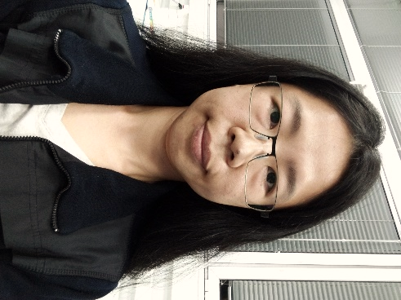
Tuesday, June 7, 2022 11:00 AM
Postdoc Seminar
1F
1F
Mapping the genotypes of cooperation
Dr. Shu-Ting You (游淑婷) Postdoctoral Research Fellow
Advisor: Dr. Yitzhak Pilpel
Department of Molecular Genetics
Weizmann Institute of Science
Rehovot, Israel
Host: Dr. Jun-Yi Leu (呂俊毅)

