Slide 1
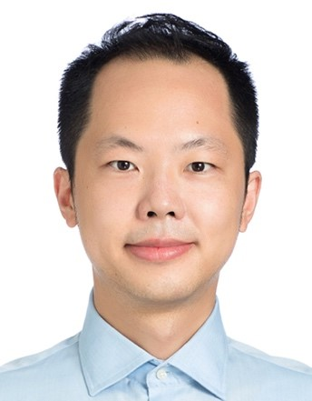
Tuesday, March 22, 2022 11:00 AM
B1
B1
Webex Link
Exploring biological phenomena with multi-resolution imaging: From Extracellular Vesicles to Genome-Editing
Dr. Charles Pin-Kuang Lai 賴品光
Associate Research Fellow
Institute of Atomic and Molecular
Academia Sinica
Taipei, Taiwan
Host: Dr. Jun-An Chen 陳俊安
Mask wearing prior to entry and QR code screen on site required

