Slide 1
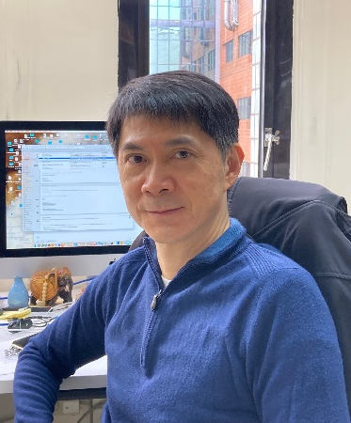
Tuesday, March 8, 2022 11:00 AM
B1
B1
Webex Link
A Hunt for the Hopeful Monster: Phenotypic Robustness and
Genetic Buffering
Dr. Jun-Yi Leu 呂俊毅 Distinguished Research Fellow
Institute of Molecular Biology
Academia Sinica
Taipei, Taiwan
Host: Dr. Sue Lin-Chao 林淑端
Mask wearing prior to entry and QR code screen on site required

