Slide 1
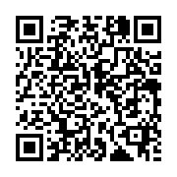
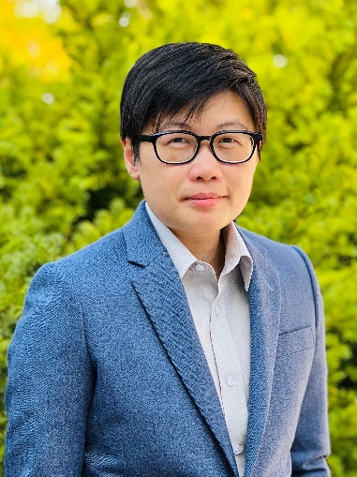
Thursday, February 24, 2022 11:00 AM
Postdoc Seminar
B1
B1
Webex Link
Interrogating the calcium dynamics of oligodendrocyte precursor cells and their progenitor fate
Dr. Tsai-Yi Lu (呂采宜) Postdoctoral Fellow
Advisor: Dr. Dwight E. Bergles
Johns Hopkins University
Baltimore, MD, USA
Host: Dr. Suewei Lin (林書葦)
Mask wearing prior to entry and QR code screen on site required

