Slide 1
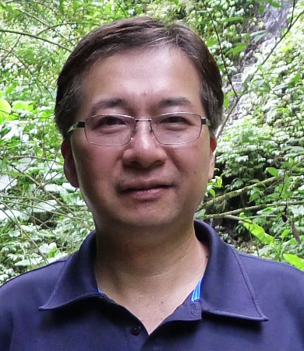
Tuesday, October 19, 2021 11:00 AM
B1
B1
Webex Link
Structural studies of Fe/2OG-dependent enzymes and MerR family of bacterial transcriptional regulators: implications for catalytic/regulatory mechanism and biotech application
Dr. Nei-Li Chan 詹迺立教授 Distinguished Professor
Inst. of Biochemistry and Molecular Biology
College of Medicine
National Taiwan University
Host: Dr. Liuh-Yow Chen
Mask wearing prior to entry and QR code screen on site required

