Slide 1
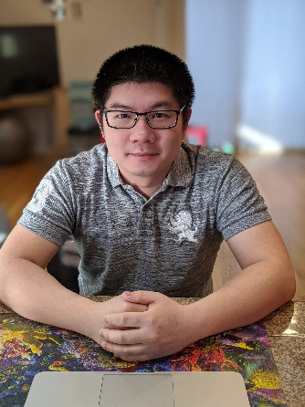
Wednesday, January 27th, 2021 10:00 AM
Recruitment Seminar
B1
B1
Molecular Mechanisms Underlying Interbacterial Warfare
Dr. See-Yeun Ting Postdoctoral Research Fellow
Department of Microbiology
University of Washington
Howard Hughes Medical Institute
USA
Host: Dr. Soo-Chen Cheng
Online seminar available only in IMB B1 auditorium No web accessibility

