Slide 1
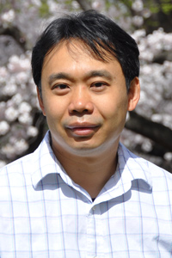
Monday, March 30, 2020 11:00 AM
Promotion Seminar
B1
B1
Conserved Protein Motifs Accommodate Functional Versatility
Dr. Kuo-Chiang Hsia Assistant Research Fellow
Institute of Molecular Biology
Academia Sinica
Host: Dr. David Hsiao

